Slide 1



Project 4: Machine Learning
Predicting Student Adaptability Levels in Online Education
Kelly Blake | Rajeshwari Radhakrishna | Aisha Henderson | Sujatha Angajala
OCTOBER 2023

Slide 2

Project Details
Description:
This project utilizes supervised machine learning methods to develop a model that can predict the level of student adaptability in online learning, based on various demographic and socioeconomic features.
What Are We Predicting?
What features influence student adaptability in an online learning setting? How can this information be leveraged to customize online learning programs and improve success for new digital learners?

Slide 3

Dataset Information
¹ Students Adaptability Level in Online Education
Column Name | Description | Type
Gender | Gender of Student | String
Age | Age range of the student | String
Education Level | Education Institution Level | String
Institution Type | Education Institution Type | String
IT Student | Studying as IT Student or Not | String
Location | Is Student Location in Town? | String
Load-Shedding | Level of load shedding | String
Financial Condition | Financial Condition of Family | String
Internet Type | Internet type used mostly in device | String
Class Duration | Daily class duration (in hours) | String
Self LMS | Institution’s Own LMS Availability | String
Device | Device Used mostly in Class | String
Adaptability Level | Adaptability level of the student | String
Data Source: Kaggle
Total Rows: 1205 Rows
The data collected was part of research conducted in Bangladesh after the onset of Covid, to understand and thus improve online learning for students across age ranges
Features
Label
¹ https://www.kaggle.com/datasets/mdmahmudulhasansuzan/students-adaptability-level-in-online-education

Slide 4
Coding and Machine Learning Tools
Postgres SQL
Jupyter Notebook
Python Pandas
SciKit Learn - Random Forest
Tableau
Database used to house data
Utilized for coding and python/machine learning libraries
Used to read in and clean data from SQL
Machine Learning Model used to train and predict dataset outcomes
Used for Data Visualization

Slide 5
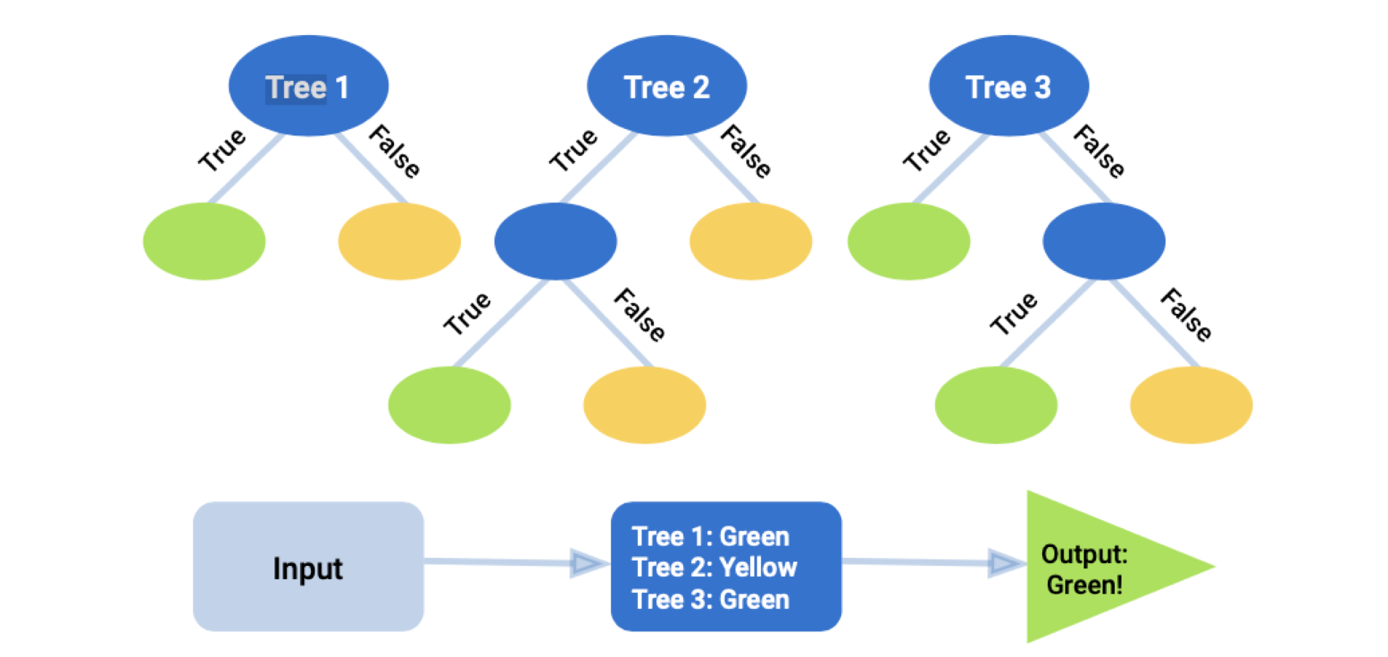
Machine Learning Model
Random Forest Algorithm
Our model was trained using the Random Forest Algorithm to address a classification problem
A class label is determined based on the input data.
The ‘Adaptability’ column used for the prediction contains multiple class labels:
High
Moderate
Low
Image Source: Trilogy Education Services, 2U, Inc.

Slide 6
Machine Learning Model
Random Forest Algorithm
For the dataset, the Random Forest Algorithm was used
The problem we are solving for is a classification problem, in which a class label was anticipated based on the inputs of data
The ’Adaptability’ column used for the prediction contains multiple class labels:
High
Moderate
Low

Slide 7

Data Visualizations

Slide 8
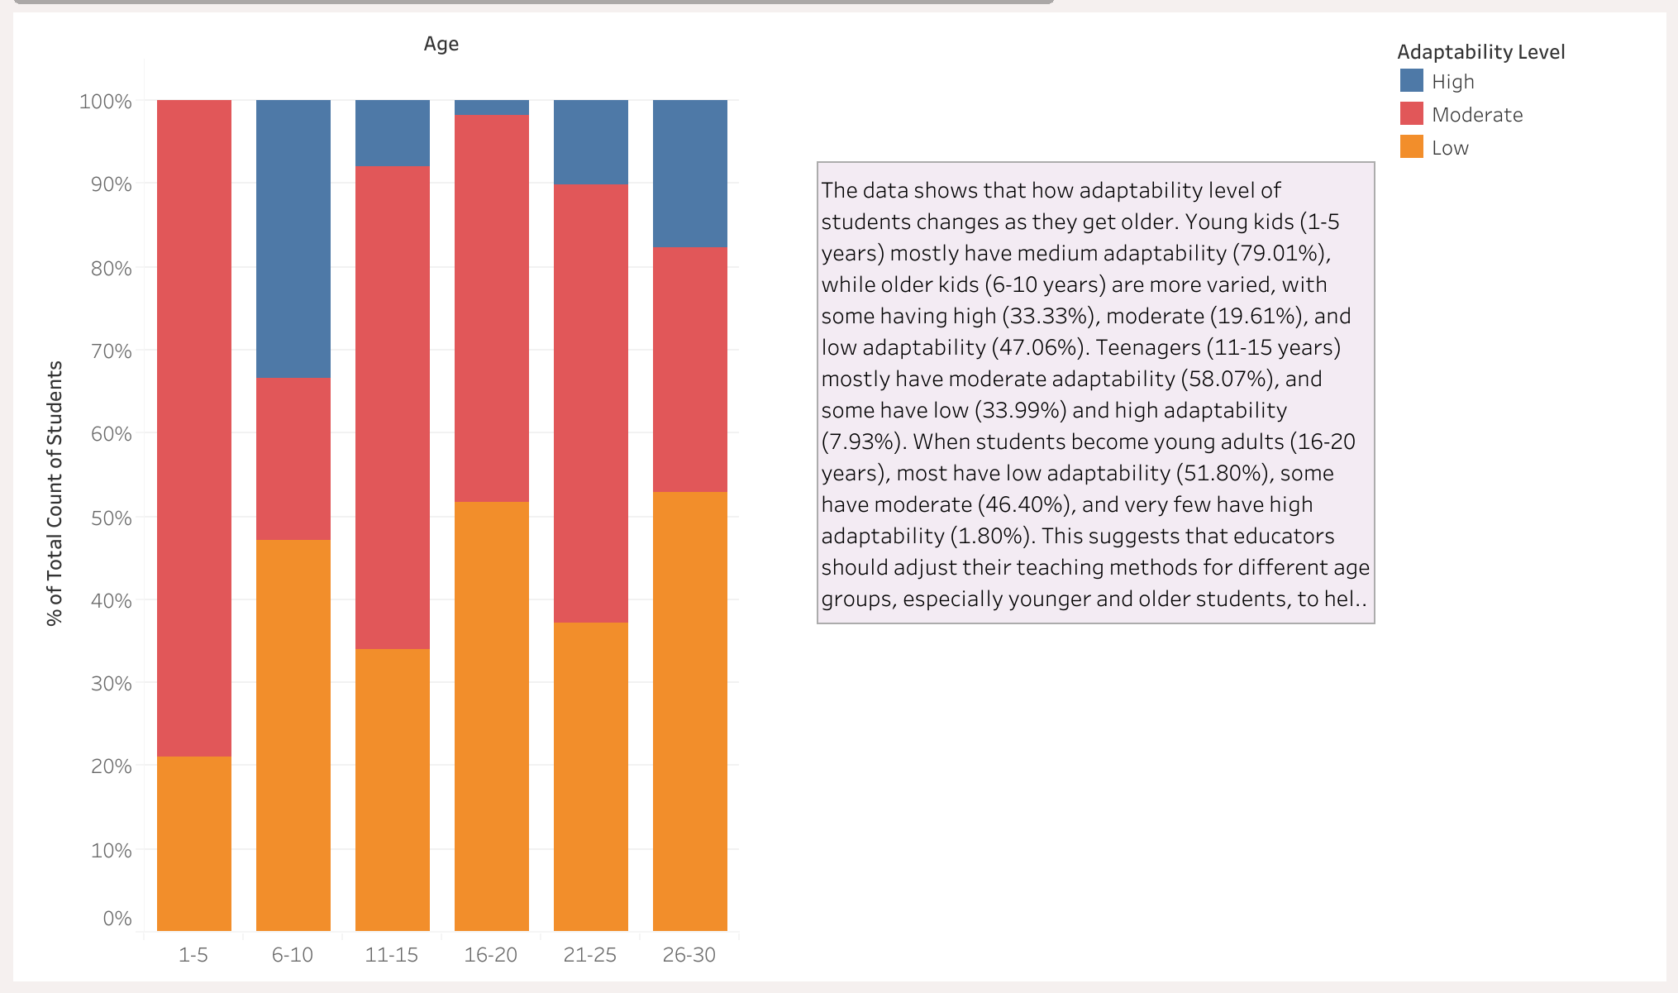
Adaptability Level by Student Age Range

Slide 9
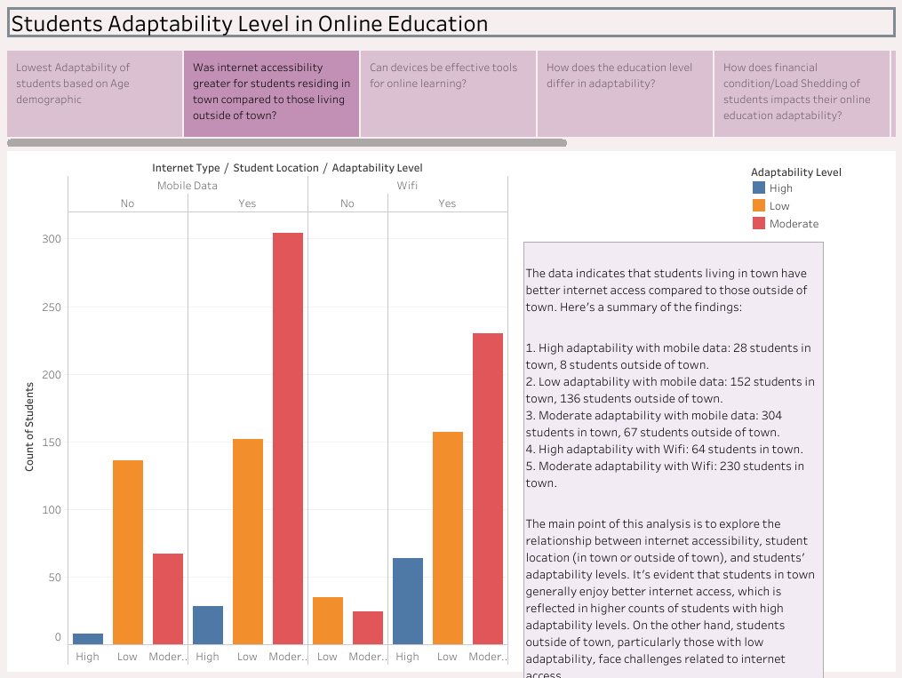
Was internet accessibility greater for students residing in town compared to those living outside of town?
Notes:
Graph displays a comparison between internet type and student location vs adaptability levels
Reading from Left to right, you can see the adaptability level for student’s using Mobile Data where No indicates the do not live in town, and Yes indicates they do live in town.
On the right side, you can see the adaptability level for student’s using Wifi where No indicates they are not living in town, and Yes indicates they do live in town.
Summary
The data shows Moderate Adaptability for All students who live in town and use mobile data or Wifi
No = Student Not in Town
Yes = Student in Town

Slide 10
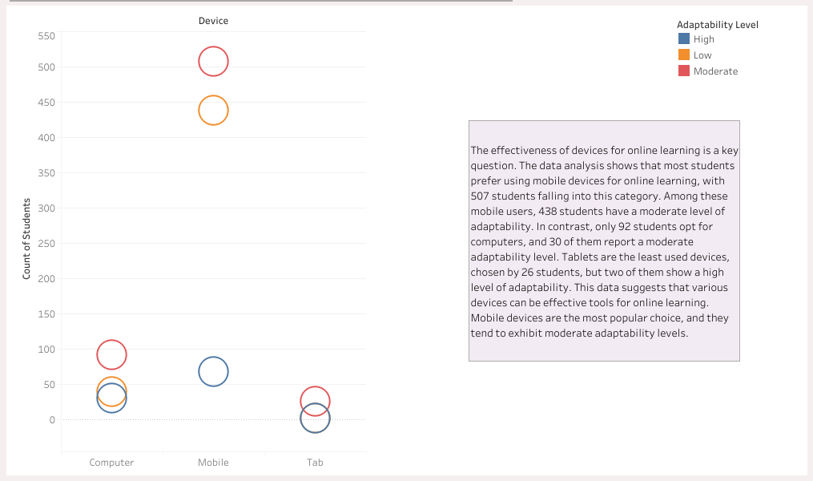
Can devices be effective tools for online learning?
Notes:
This visualization shows if devices are effective tools for online learning. Mobile devices represented the majority of the device type used in the dataset. Use of the mobile device type correlated the most with Low and Moderate adaptability levels

Slide 11
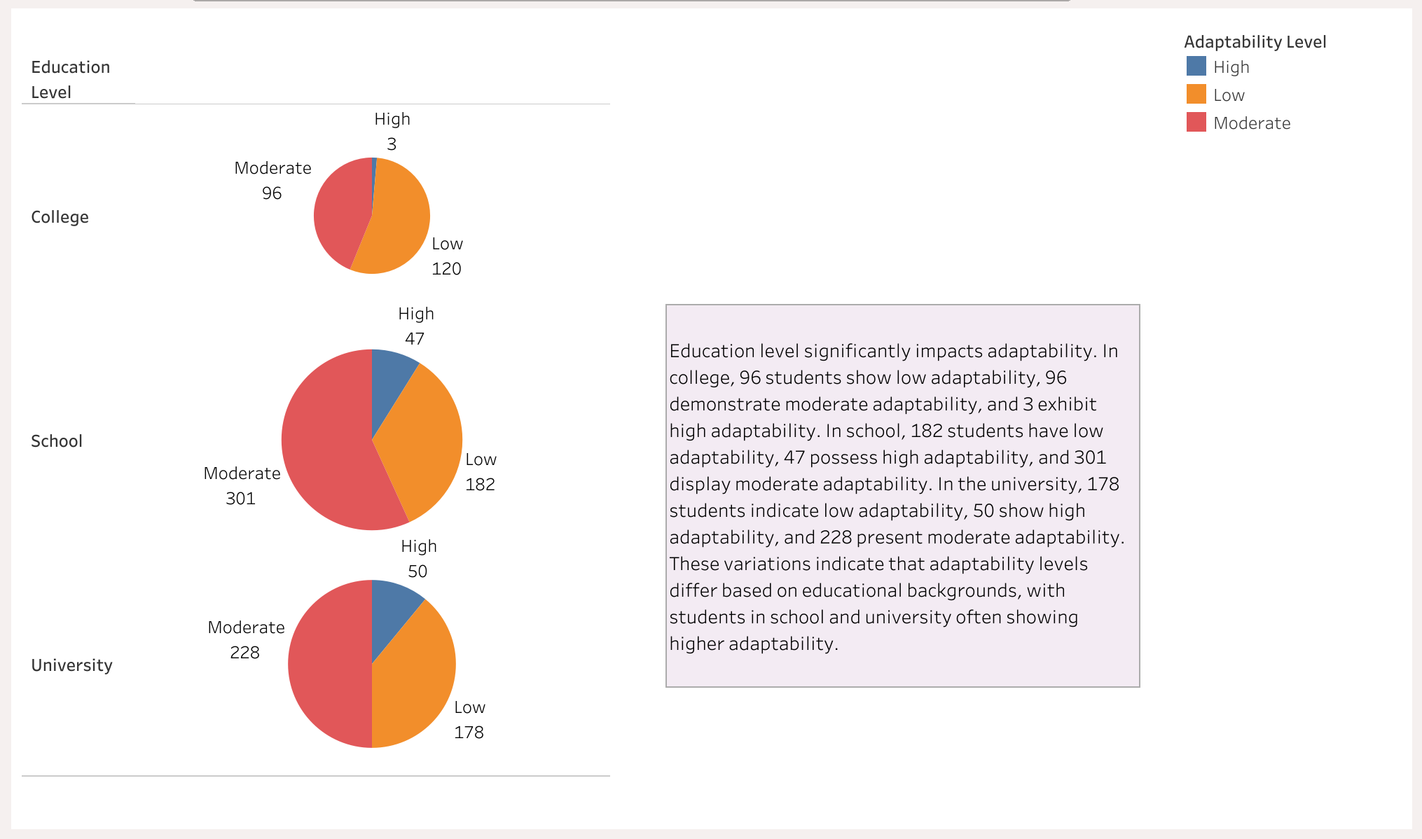
How does the education level differ in adaptability?
Notes:
These pie charts shows adaptability for each education level. This is not a comparison between education levels, but rather shows how students in college, school, or university are able to adapt to online learning.
Students in the University and School education buckets show a higher adaptability.

Slide 12
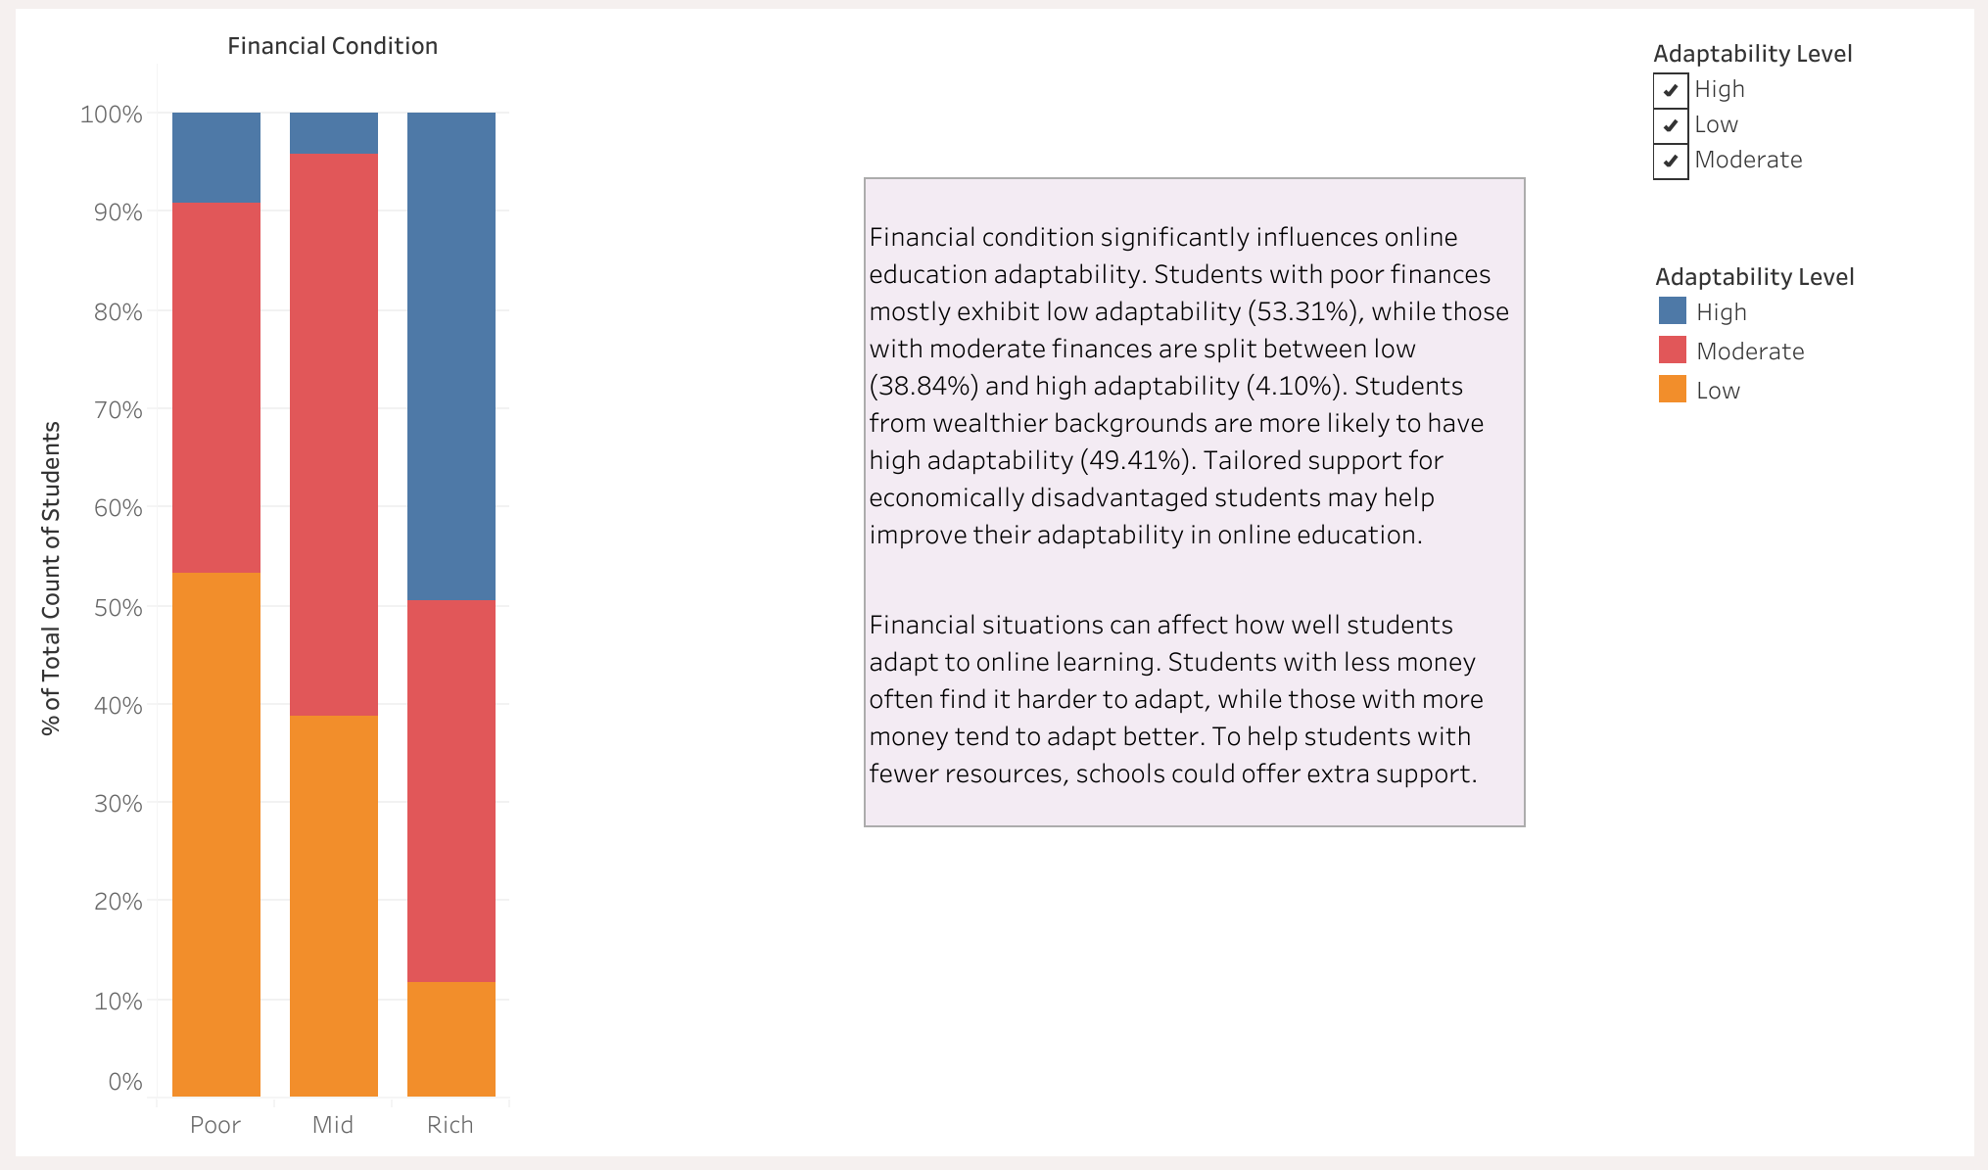
How does the Financial Condition of Students impact their online education adaptability?
Notes:
This bar chart shows how students’ financial conditions impact adaptability levels
The three values assessed for financial condition include Poor, Mid (middle class), and Rich
This dataset indicates that load shedding severely impacts poor and middle-class students, leading to Lower adaptability. In contrast students in the Rich financial class experience lower load shedding, and still maintain a higher rate of adaptability

Slide 13
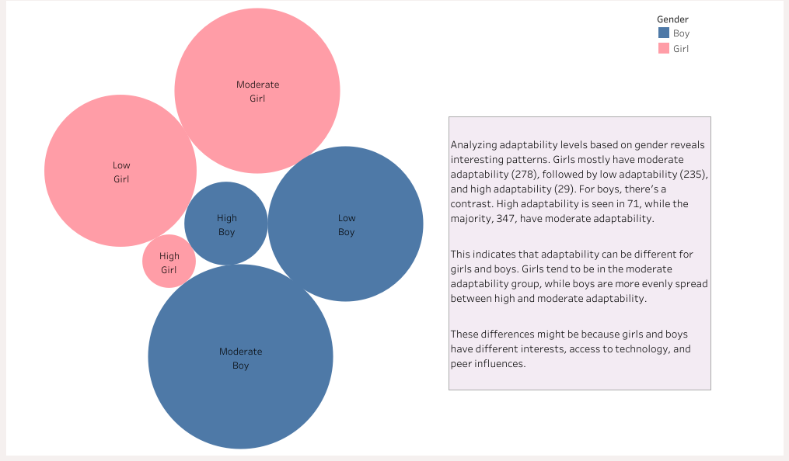
Does adaptability differ based on student’s gender?
Notes:
This visualization shows adaptability levels based on gender. High adaptability levels is higher among boys vs girls. Moderate adaptability levels are slightly higher in boys vs girls. Low adaptability levels are very similar among both genders. When comparing this to our feature importance, this aligns with the analysis that gender as a feature had a significant effect on the model when predicting the outcomes

Slide 14
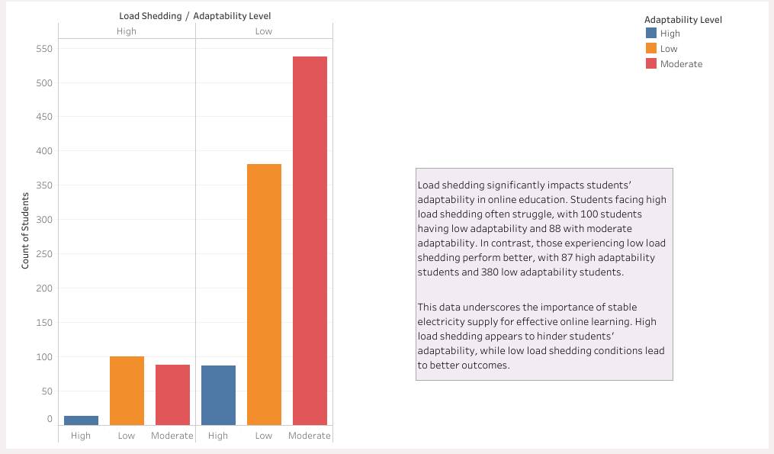
How does Load Shedding affect the adaptability of students in the context of online education?
Notes:
This bar chart shows the impact of Load Shedding on student adaptability.
For context, load shedding is the deliberate shutdown of electric power in parts of a power distribution system, which one would perceive to have a significant impact to student adaptability. The majority of students in our dataset experienced low levels of load shedding but adaptability levels for this feature were Low (with 380 students) or Moderate (with over 500 students). This indicates that load shedding may not be a significant factor in student adaptability.

Slide 15
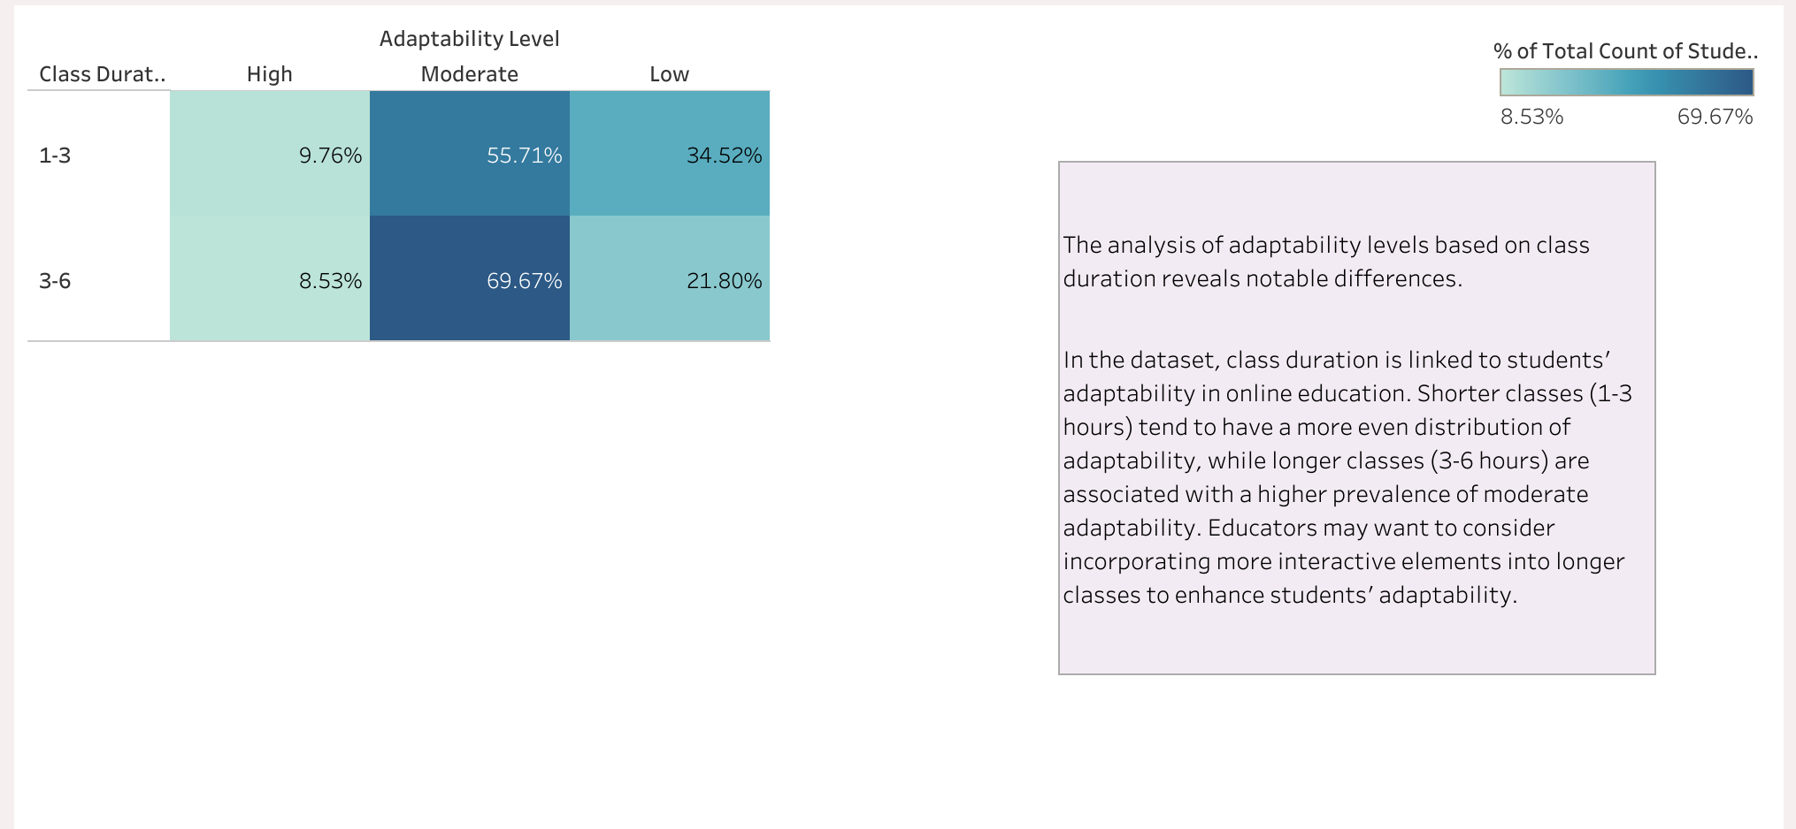
What is the relationship between Class Duration and student’s adaptability?

Slide 16
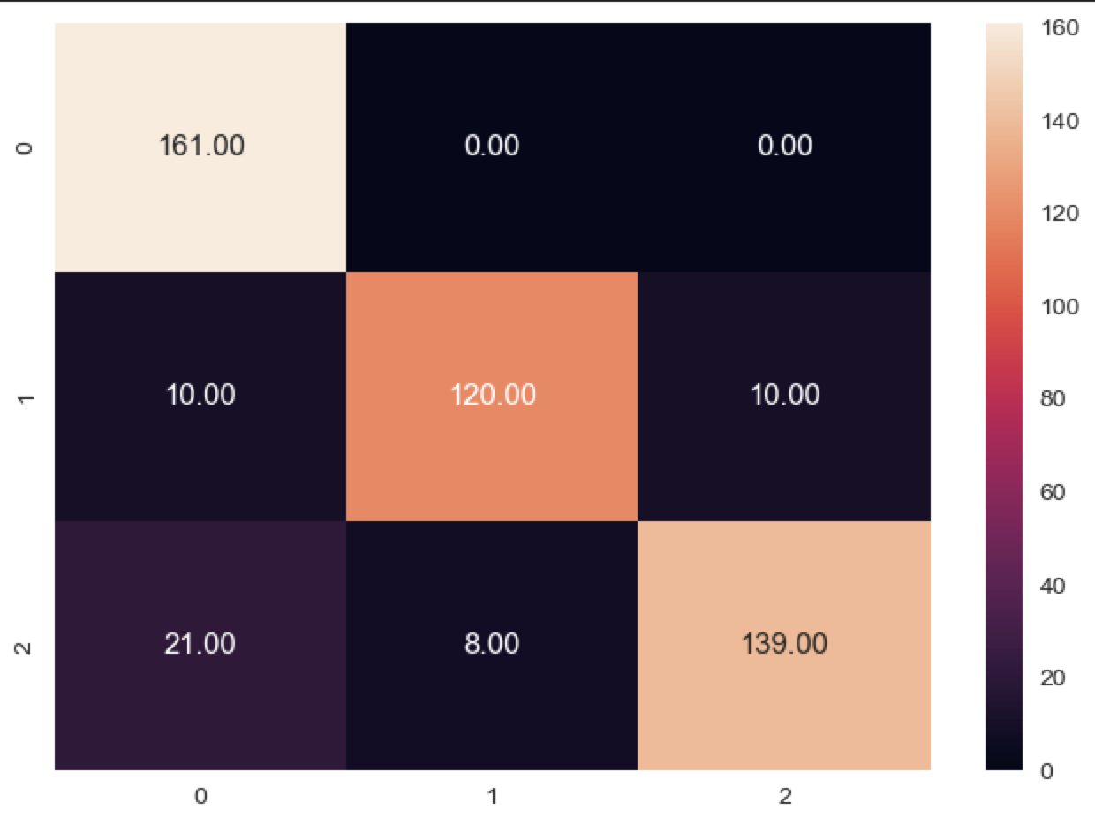
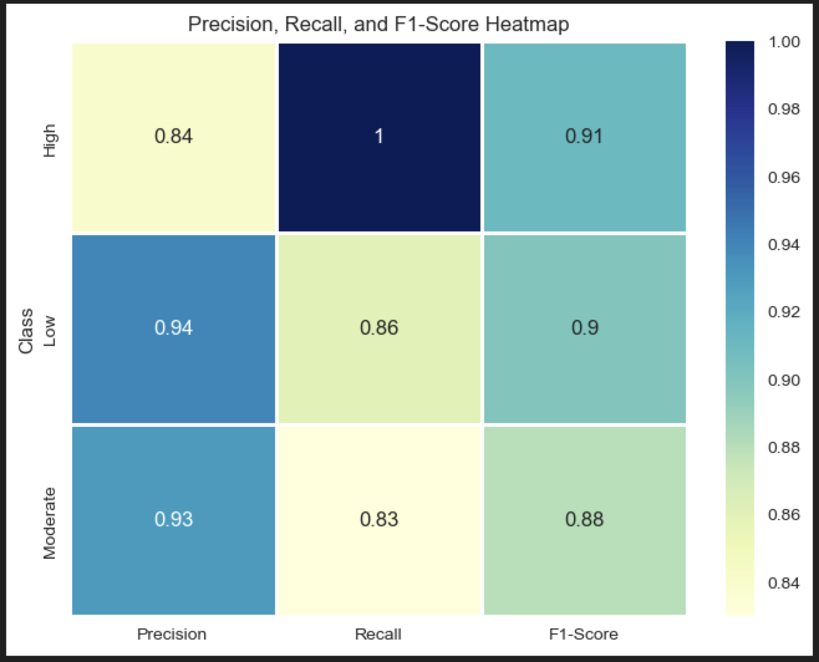
Final Analysis / Conclusion
Confusion Matrix
Classification Report
The final confusion matrix, after balancing the data with RandomOverSampler reflects the model’s effectiveness in classifying adaptability levels, with a notable ability to distinguish “High” adaptability, strong performance for “Low” adaptability, and accurate predictions for “Moderate” adaptability
The final Classification Report reflects the model’s effectiveness, with strong precision for predicting Moderate and Low adaptability levels, and accurate precision for High adaptability levels.
Inversely, the recall scores indicate strong prediction for ‘True Positives’ for High adaptability, and accurate recall for the Low and Moderate classes
Overall accuracy for the model indicates that 90% of the time, student adaptability levels were classified correctly

Slide 17
THANK
YOU!

